Slide 1
Robotic Seminar
Second meeting 28-Nov
Mingyuan Chi

Slide 2
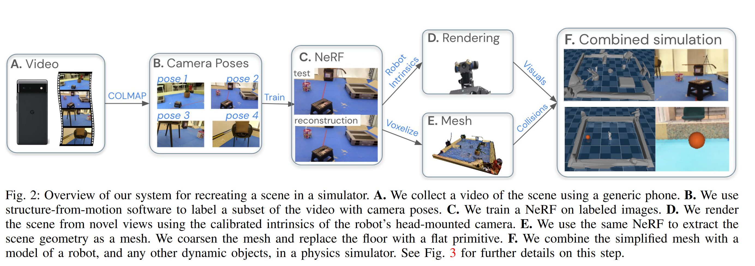
Limitation:
1. manual postprocessing is required, (minimally textured area)
2. Should sperate process static scene and dynamic objects
3. high cost of NeRF
Advantage:
1. NeRF significantly reduces the sim2real gap with realistic scene renderings
2. videos from commodity mobile devices to create realistic simulations. This makes the system accessible and practical, as it doesn't require specialized hardware.
RGB
Neural Field
Nerf2real: Sim2real transfer of vision-guided bipedal motion skills using neural radiance fields
Sensor : Camera(Phone)

Slide 3
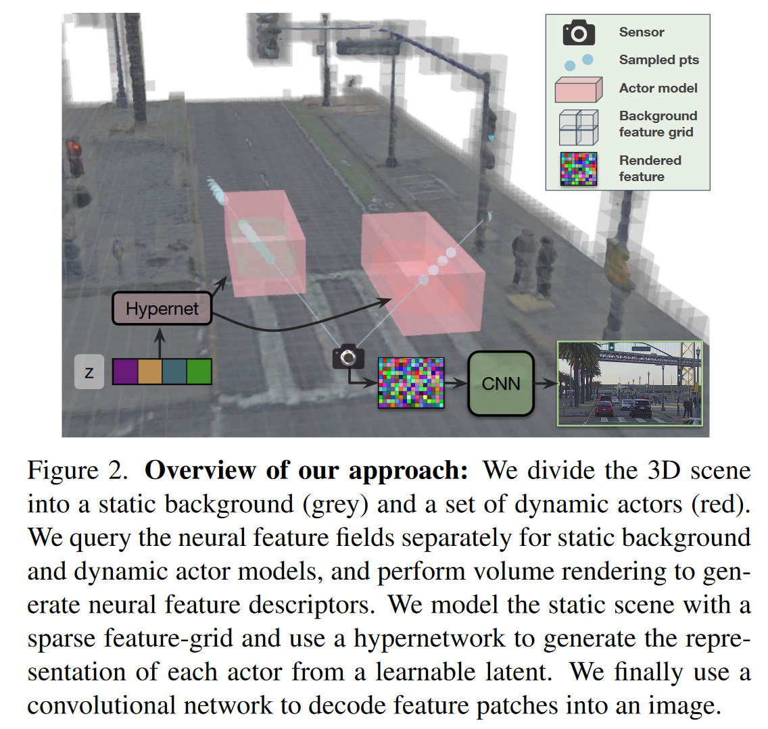
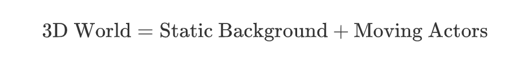
RGB
Neural Field
UniSim: A Neural Closed-Loop Sensor Simulator
Sensor : Camera & LiDAR
Limitation:
1. requires LiDAR
2. complex pipeline
Advantage:
1. using voxel rendering to leverage the computational cost
2. produce higher-fidelity LiDAR simulation with less noise
3. closed loop simulation

Slide 4
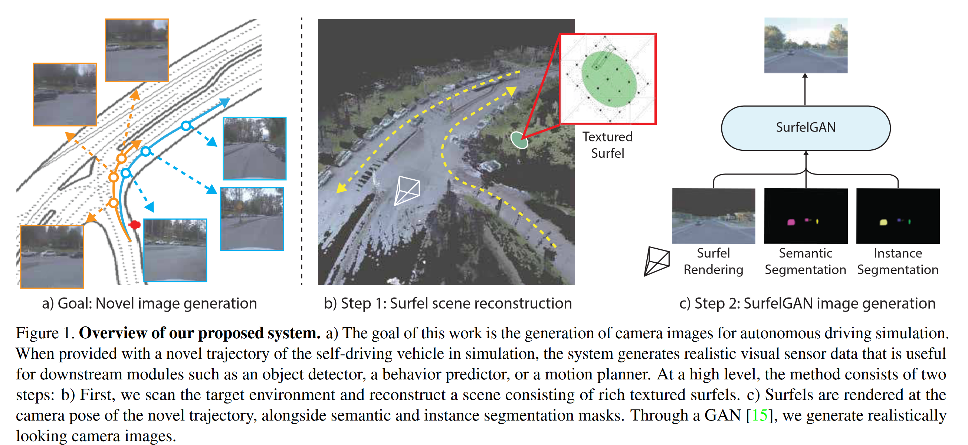
Advantage :
1. the first to build purely data-driven camera simulation system for autonomous driving.
2. High realism
Limitation:
1. SurfelGAN unable to recover from broken geometry
2. Place where surfel map does not cover will cause Hallucination
3. complex training process(Semantic Segmentation, Instance Segmentation)
RGB
Synthetic Dataset
SurfelGAN: Synthesizing Realistic Sensor Data for Autonomous Driving
Sensor: Camera & LiDAR
Purpose : Generate
realistically looking
camera images (Texture)
Method :
Surfel : A surfel is a small, oriented disk used to represent a portion of a 3D surface.

Slide 5
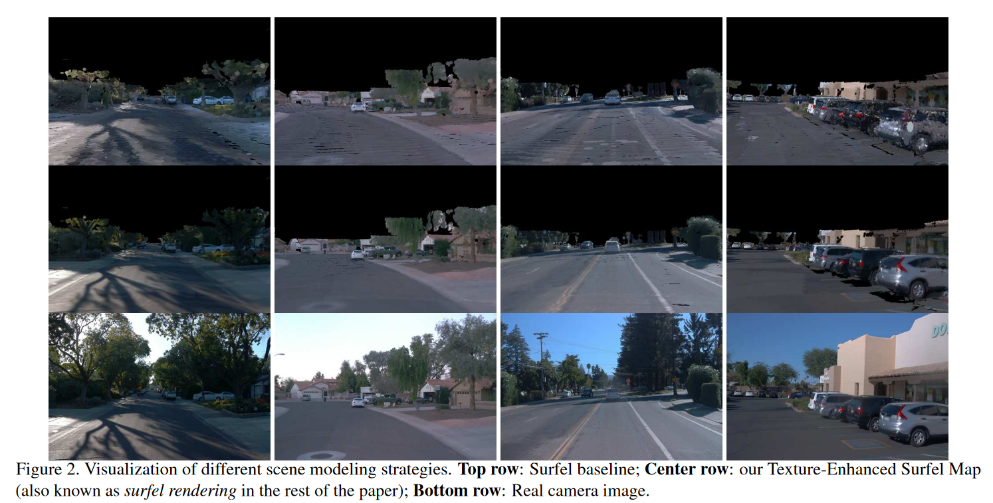
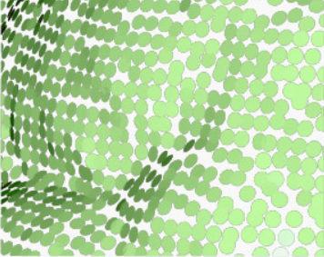
RGB
Synthetic Dataset
SurfelGAN: Synthesizing Realistic Sensor Data for Autonomous Driving
Surfel(surface element) : A surfel is a small, oriented disk used to represent a portion of a 3D surface.

Slide 6
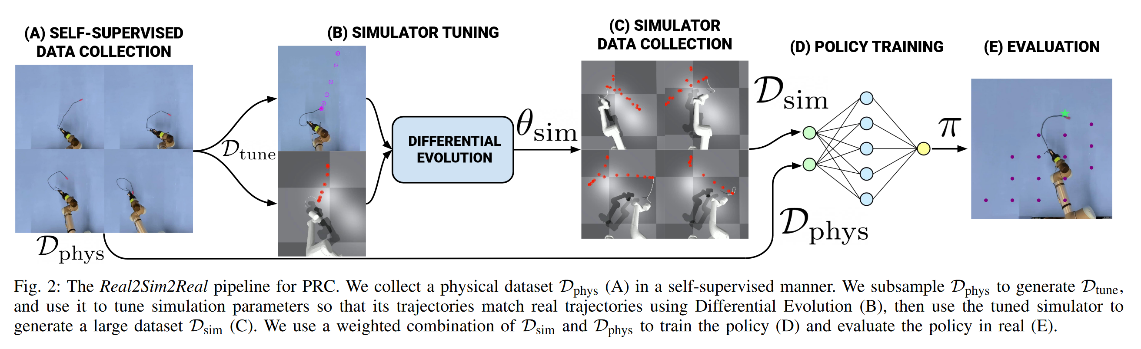
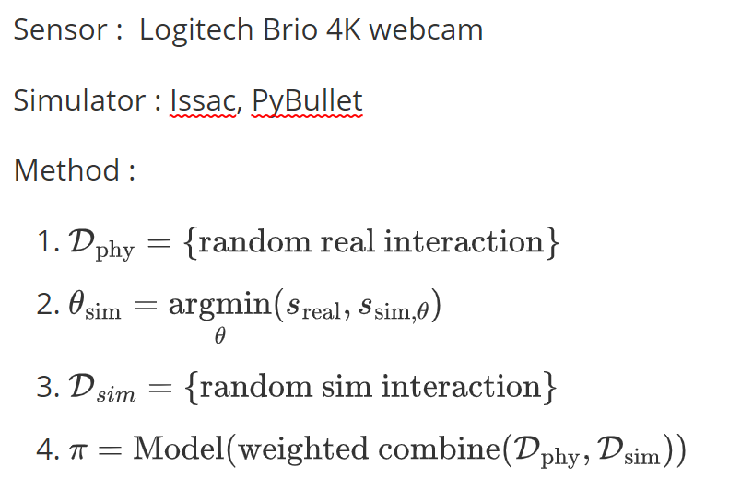
RGB
Advantage :
1. self supervised, no manual data labeling and intervention
2. efficient learning from few physical examples (sim + real)
Limitation :
1. harder to extend to 3D , inherent uncertainty about static and dynamic friction
Synthetic Dataset
Real2Sim2Real: Self-Supervised Learning of Physical Single-Step Dynamic Actions for Planar Robot Casting
PRC : Planar Robot Casting

Slide 7
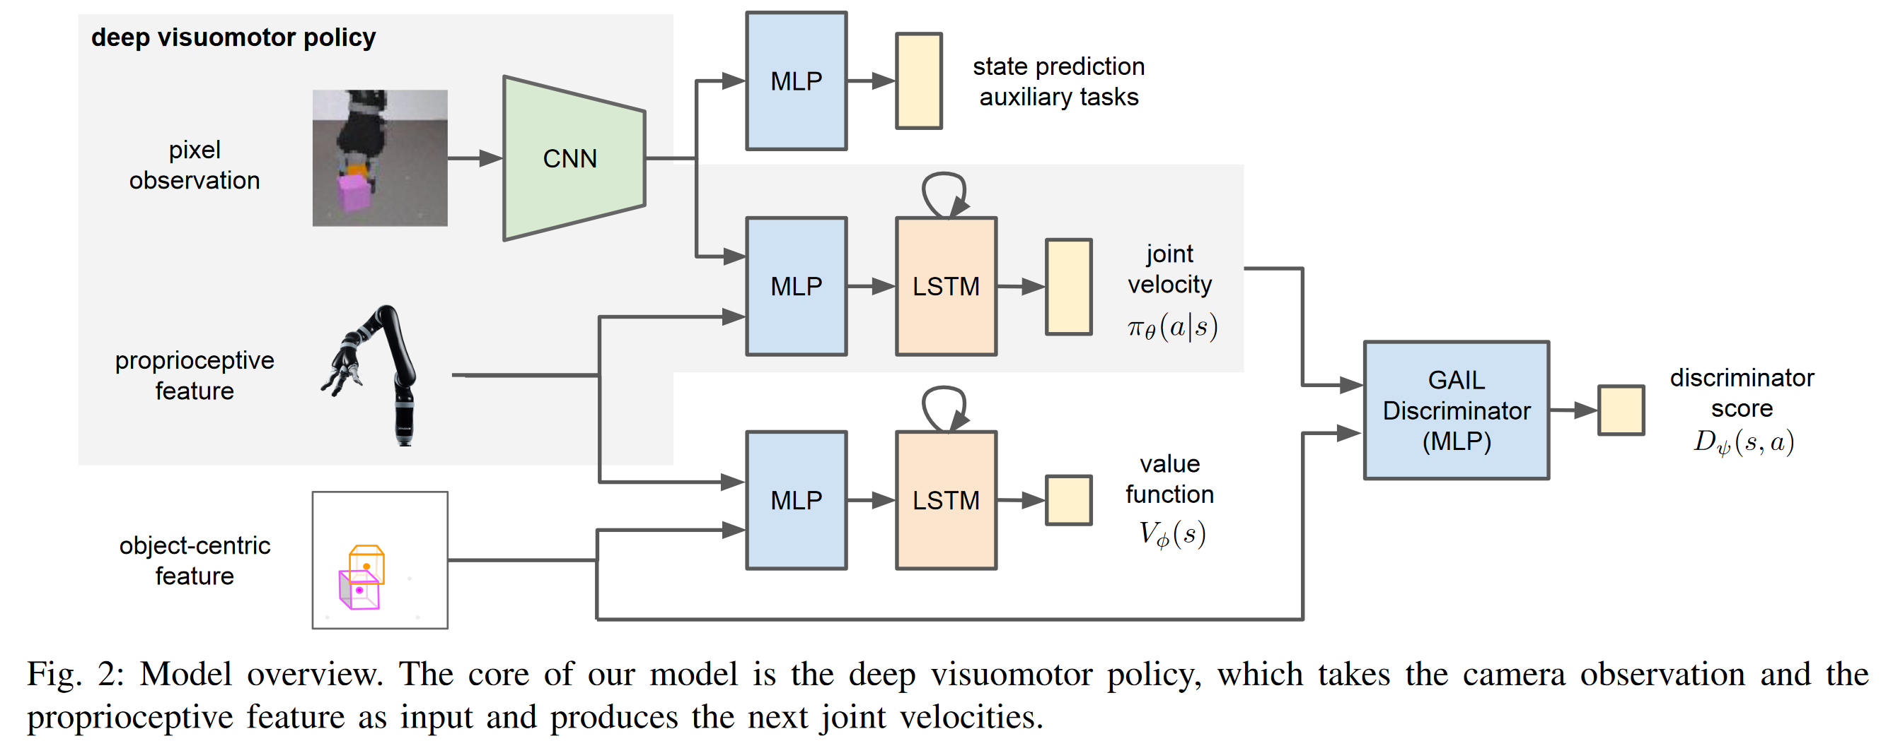
Advantage :
1. reinforcement learning + limitation learning
2. diverse task from small amount of human demonstration data
Limitation :
1. Reality Gap in Sim2Real Transfer
2. simulation’s dynamics parameters were manually adjusted
RGB
Simulation Manually Adjusted
Reinforcement and Imitation Learning for Diverse Visuomotor Skills
a Kinect camera (RGBD) was visually calibrated to match the position and orientation of the simulated camera, and the simulation’s dynamics parameters were manually adjusted to match the dynamics of the real arm.
GAIL : Generative Adversarial Imitation Learning

Slide 8
Depth
Sensors
LiDAR : determining ranges by targeting an object or a surface with a laser and measuring the time for the reflected light to return to the receiver .
Kinect : the motion sensing device for the Xbox 360 gaming console. It provides RGB, Infra-Red (IR), depth, skeleton, and audio streams to an application.
Zed Camera : neural depth, built-in IMU
RealSense : long range depth camera, built-in IMU

Slide 9
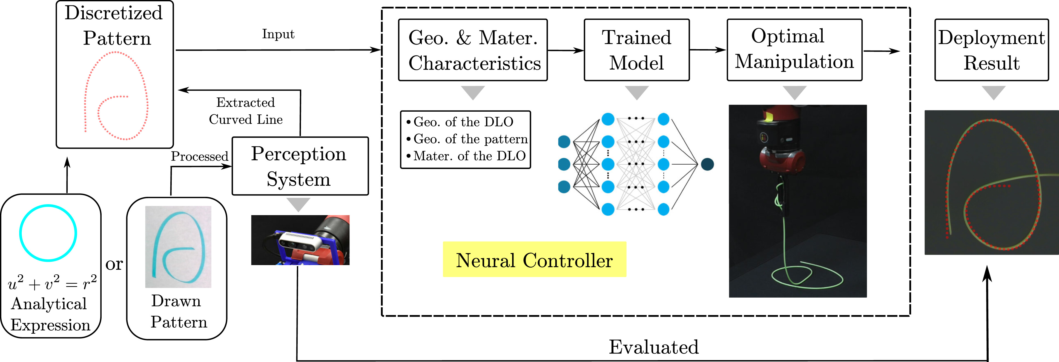
Depth
Naive
Sim2Real Neural Controllers for Physics-Based Robotic Deployment of Deformable Linear Objects
Sensor : realsense
Limitation :
- precision is not that good
- it's task specified , not generalized
Advantage :
- simple architecture but effective
DLO : Deformable linear objects

Slide 10
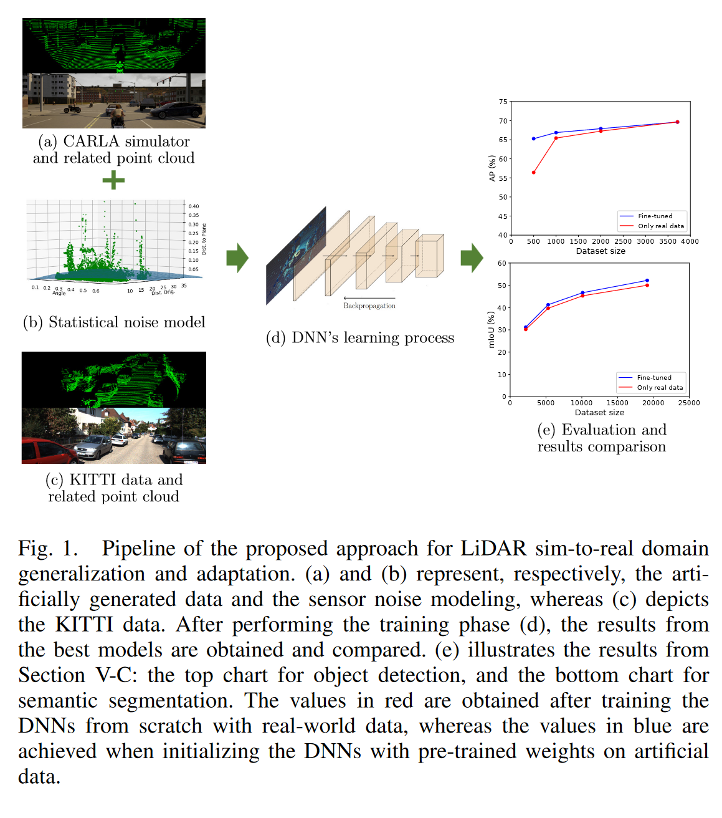
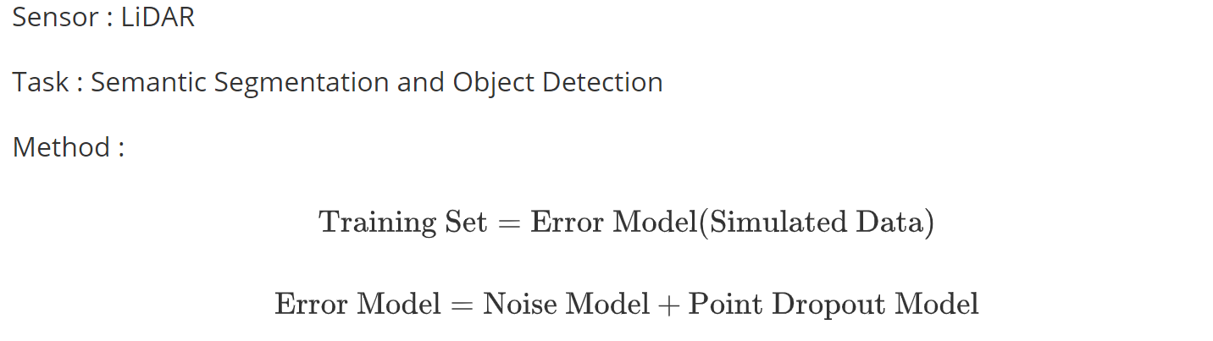
Depth
Domain Randomization
LiDAR Data Noise Models and Methodology for Sim-to-Real Domain Generalization and Adaptation in Autonomous Driving Perception
Advantage :
- naive but effective
Limitation :
- assumption of Gaussian additive model(Noise Model) and Bernoulli distribution approximation(Point Dropout Model)

Slide 11
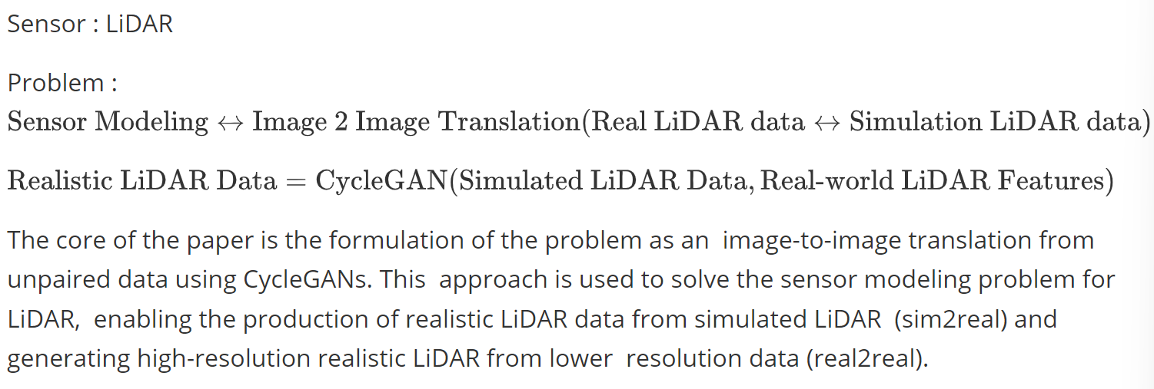
Depth
Realistic Simulation
LiDAR Sensor modeling and Data augmentation with GANs for Autonomous driving
Advantage:
- formulize the sensor modeling as image2image translation
- easy pipeline
Limitation:
- NST requires workarounds via heuristics to feed the style with every frame generation.

Slide 12
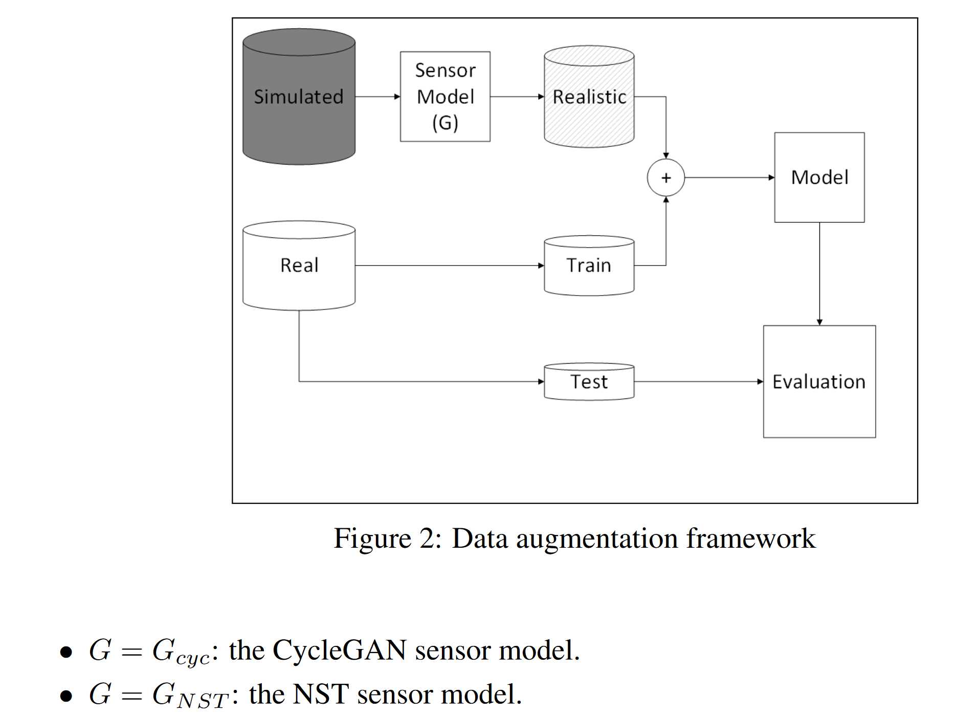
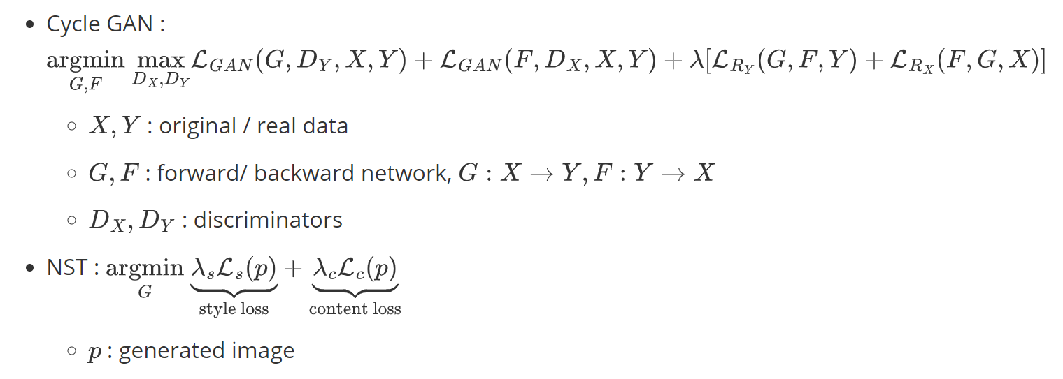
Depth
Data Augmentation
Unsupervised Neural Sensor Models for Synthetic LiDAR Data Augmentation
Advantage :
1. two available generator
Limitation :
1. highly depend on cycleGAN and NST

Slide 13
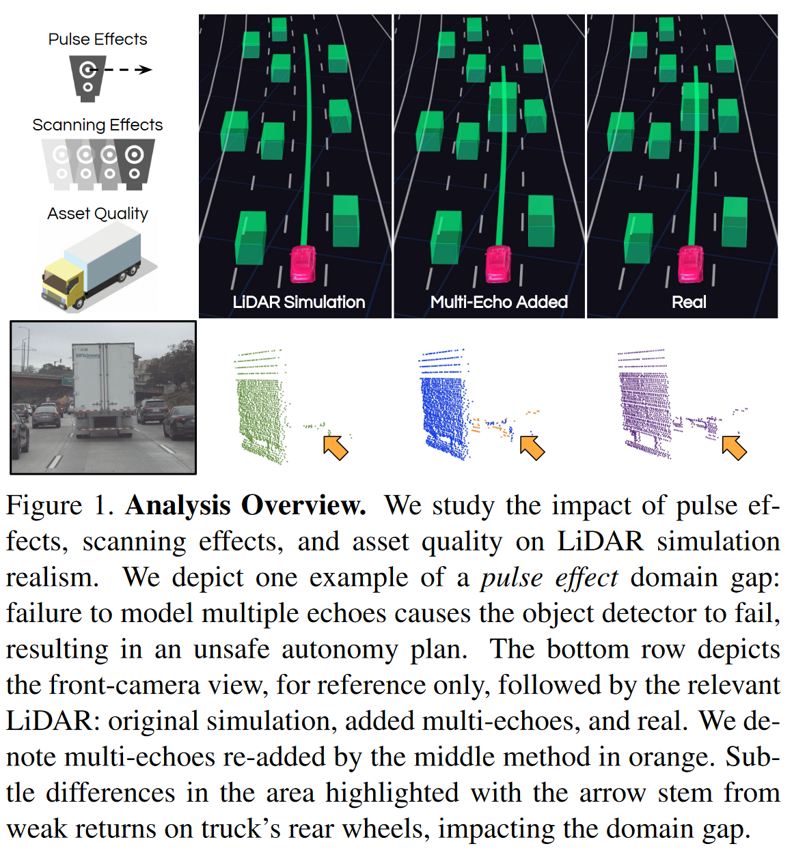
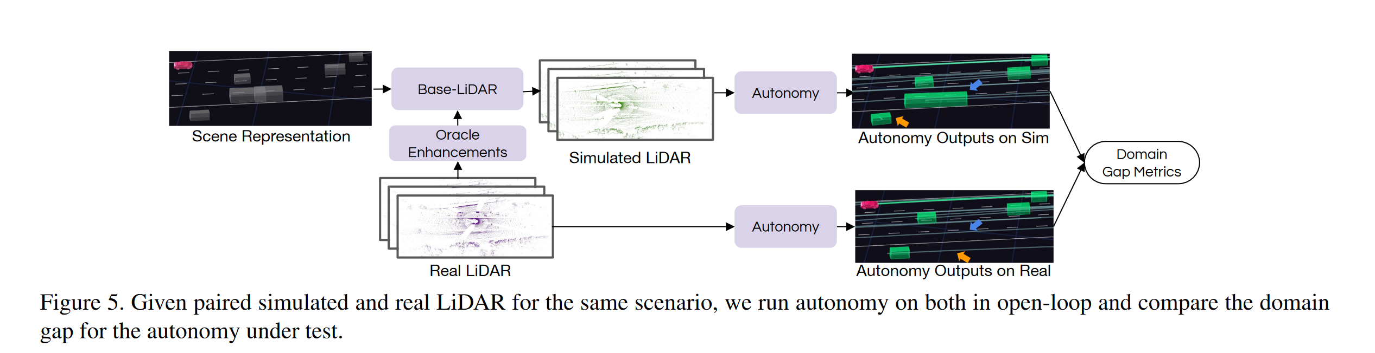
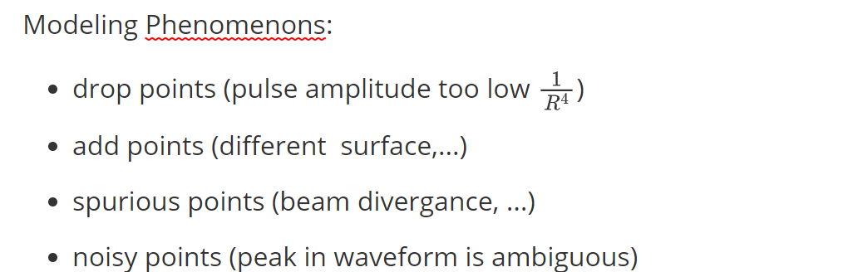
Depth
Advantage :
- Comprehensive Analysis of LiDAR Phenomena
Limitation :
- Focus on Analysis Rather Than Solution
Simulation Enhancement
Towards Zero Domain Gap: A Comprehensive Study of Realistic LiDAR Simulation for Autonomy Testing

Slide 14
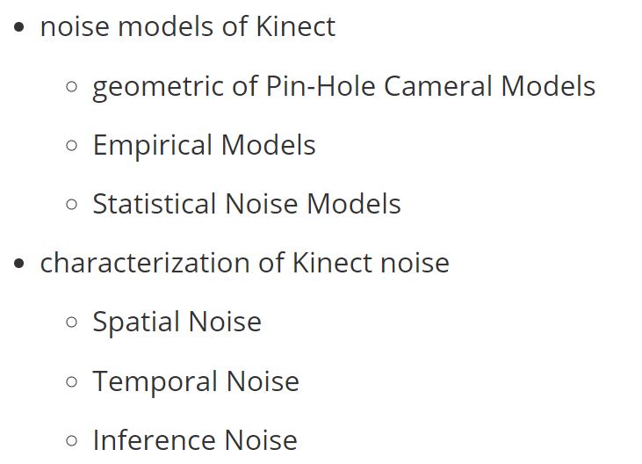
Depth
Kinect Survey
Characterizations of Noise in Kinect Depth Images: A Review

Slide 15
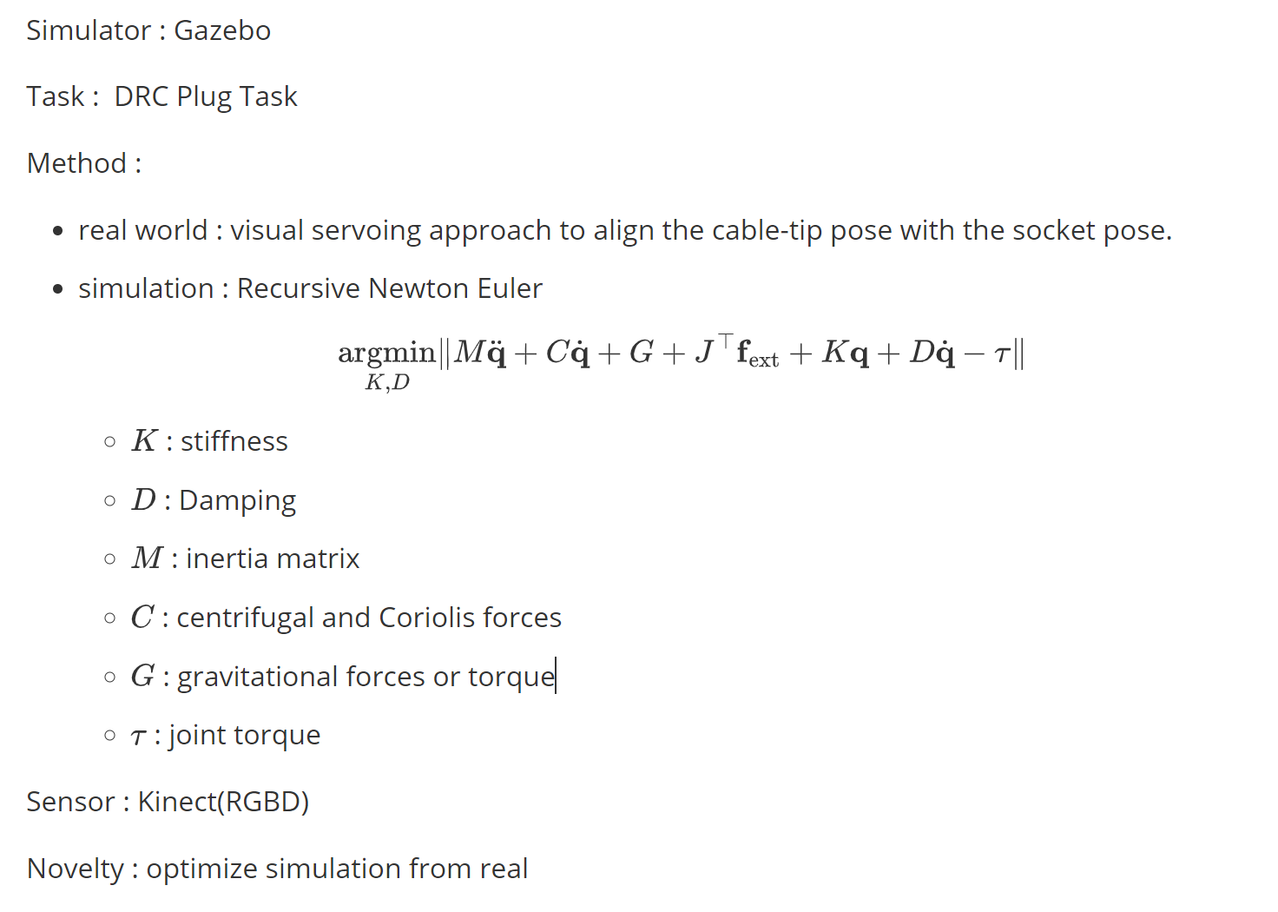
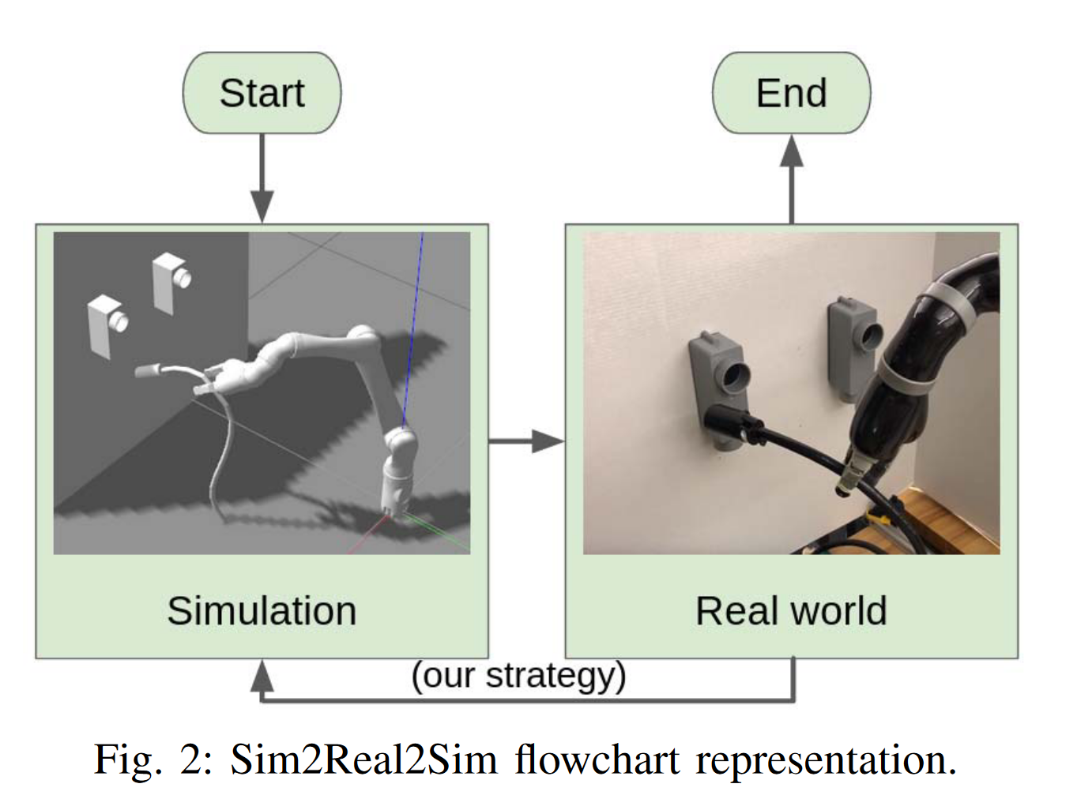
Depth
Advantage :
- simulation has real world feedback
Limitation :
- The strategy, while effective, is specifically developed for flexible object manipulation.
Realistic Simulation
Sim2Real2Sim: Bridging the Gap Between Simulation and Real-World in Flexible Object Manipulation

Slide 16
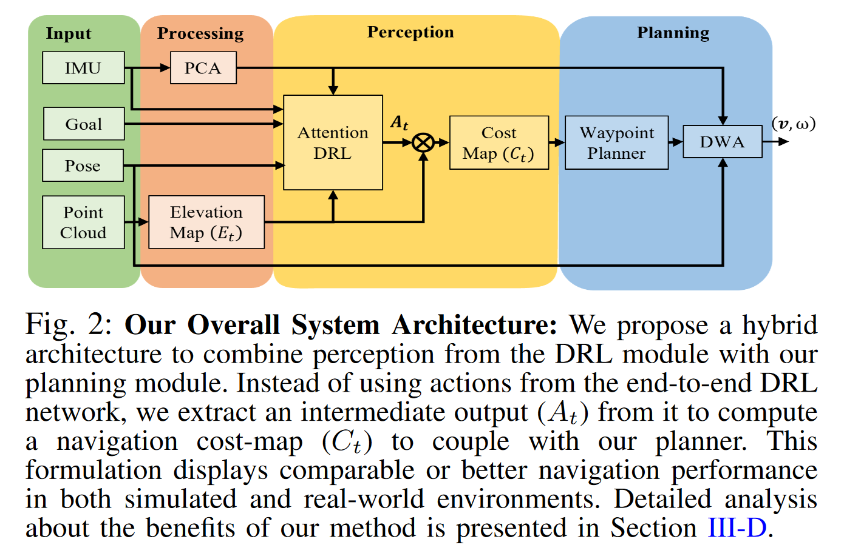
IMU
Advantage :
- avoid potential noise in the IMU signal
Limitation :
- The current formulation of the robot's navigation system does not include the capability to avoid rough terrains
Policy Modal
Sim-to-Real Strategy for Spatially Aware Robot Navigation in Uneven Outdoor Environment
point cloud is gained from LiDAR
DWA: Dynamic Window Approach to penalize velocities that could cause robot flip-overs
IMU is processed by PCA

Slide 17
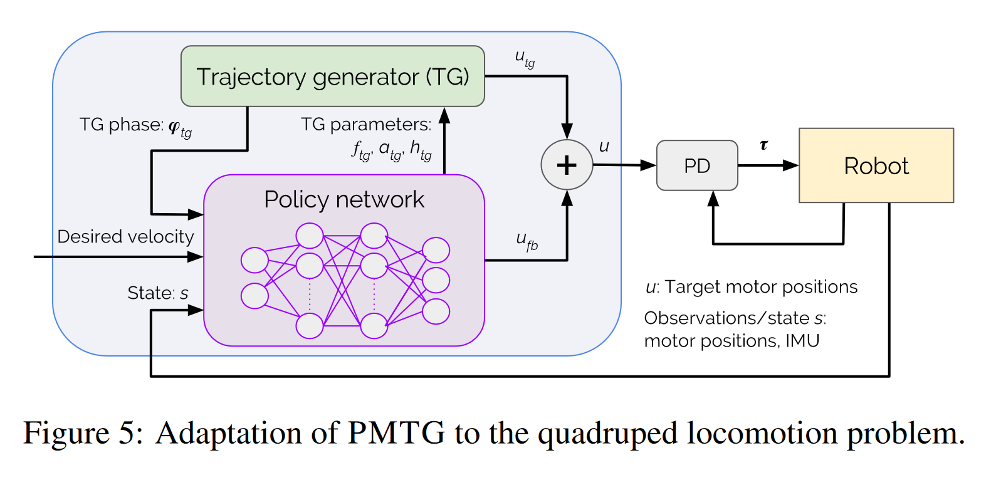
IMU
Policy Modal
Advantage :
- IMU signal coupled in the policy network
Limitation :
- The current approach relies on trajectory generators chosen based on intuition rather than a systematic method.
- only IMU, motor position information
Policies Modulating Trajectory Generators
IMU as modal for policy

Slide 18
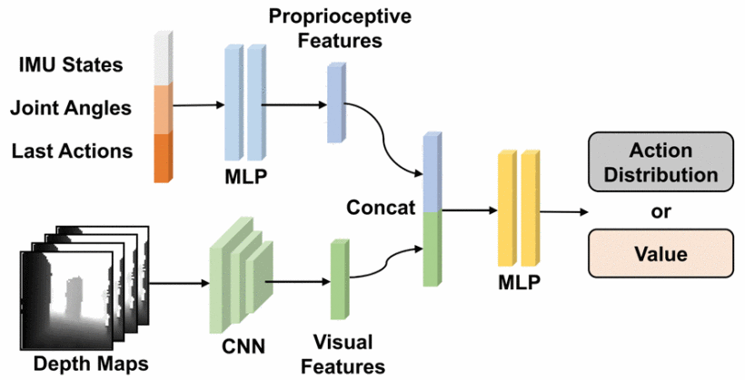
IMU
Policy Modal
Sim-to-Real Strategy for Spatially Aware Robot Navigation in Uneven Outdoor Environment
IMU as modal input for policy
Advantage :
- IMU signal coupled in the policy network
- Multi-Modal information
Limitation :
- asynchronous multi-modal inputs for RL policies

Slide 19
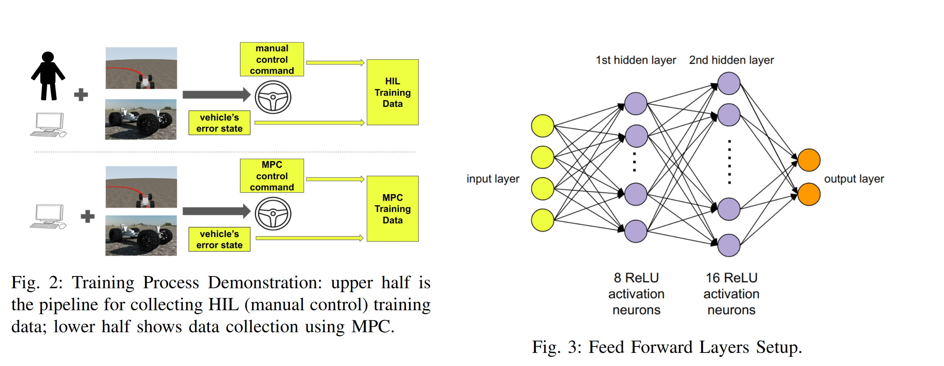
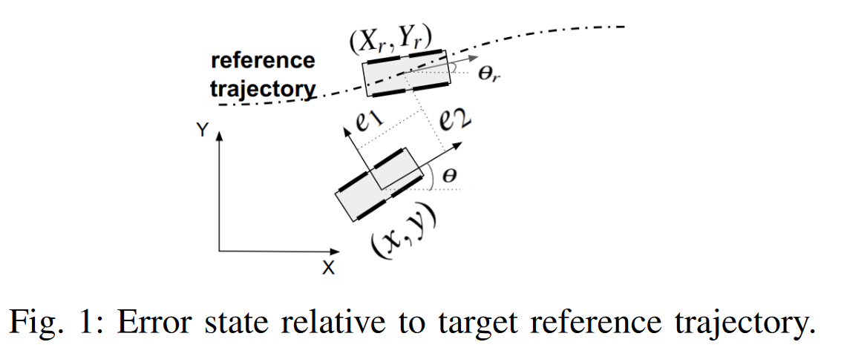
IMU
Advantage:
- explainable coupled with IMU signal
Limitation :
- naive control
- IMU signal is assumed to be exact
Error Esimation
Zero-Shot Policy Transferability for the Control of a Scale Autonomous Vehicle
IMU for error estimation

Slide 20
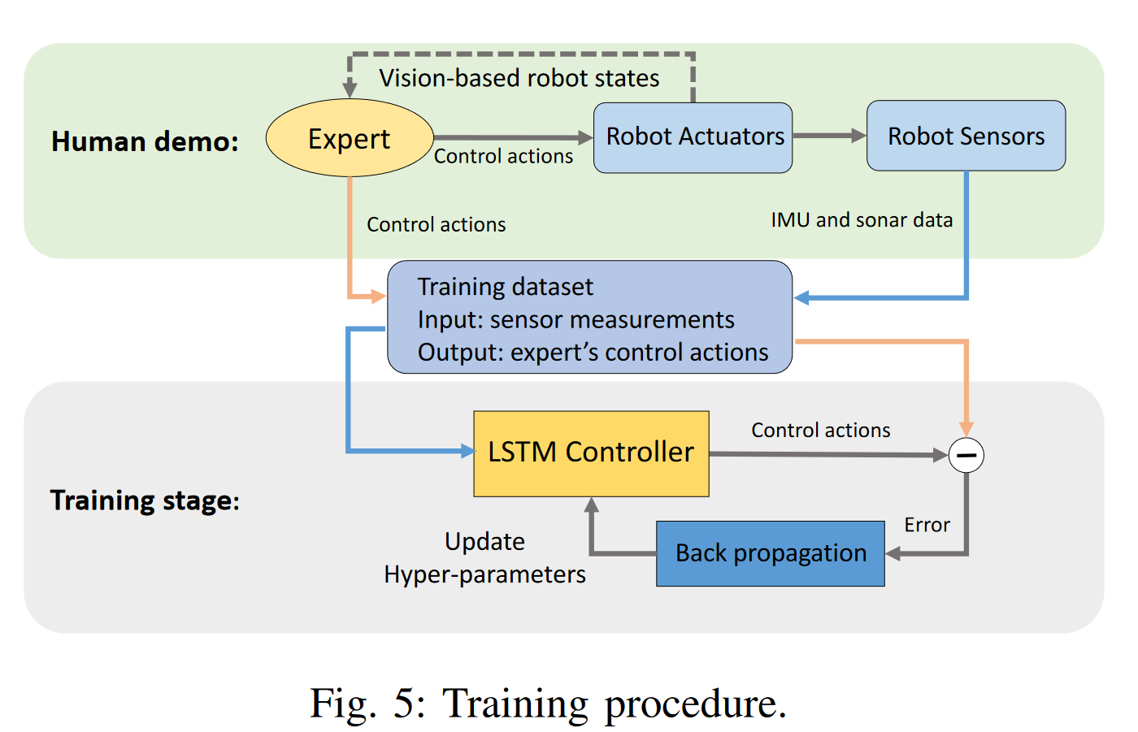
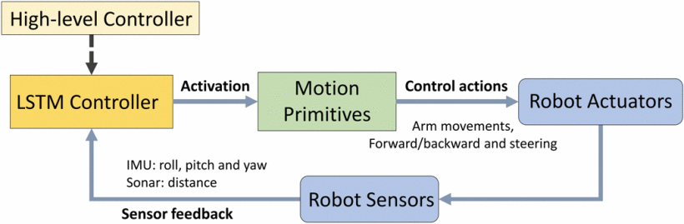
IMU
Advantage :
- considering the time sequence influence of the IMU signal
Limitation :
- not coupled with policy, only the acuators controller
Controller Modal
Learning Autonomous Mobility Using Real Demonstration Data)
Time sequence IMU modeling with NN

Slide 21
Force Sensor
Review
Robotic tactile perception of object properties: A review
Single-point contact sensor :
measure contact force : ATI Nano 17 force-torque sensor
measure vibration : biomimeticwhiskers
Tactile Array: fiber optics, MEMS barometers, RoboTouch, DigiTacts
optical tactile sensor, high resolution : GelSight, GelTip, TacTip, DIGIT

Slide 22
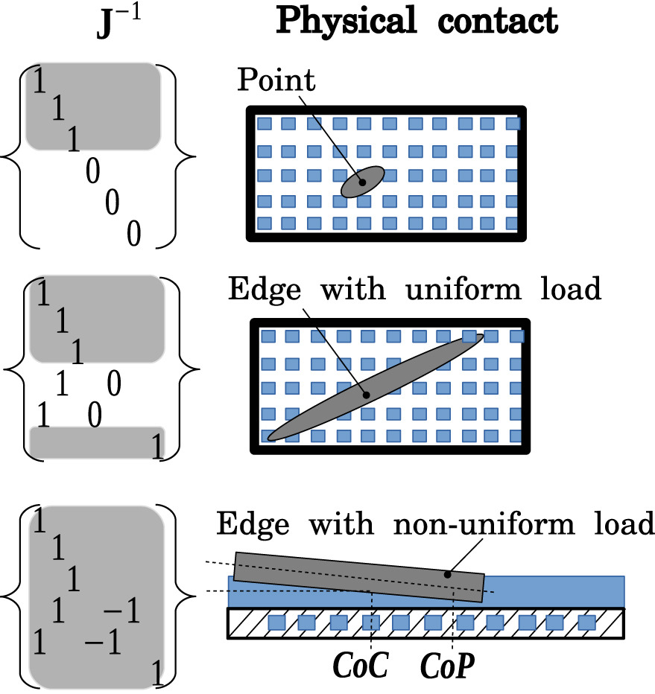
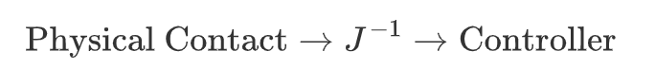
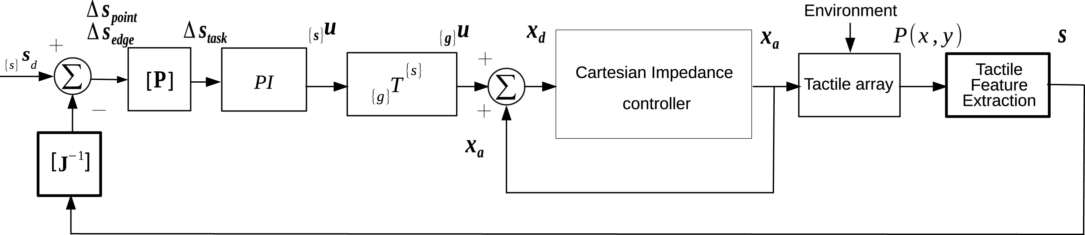
Force Sensor
Advantage :
- numerical robust
- fast
Limitation :
- not precise enough
- limit to specific contact configuration
Jacobian feed forward
Touch driven controller and tactile features for physical interactions

Slide 23
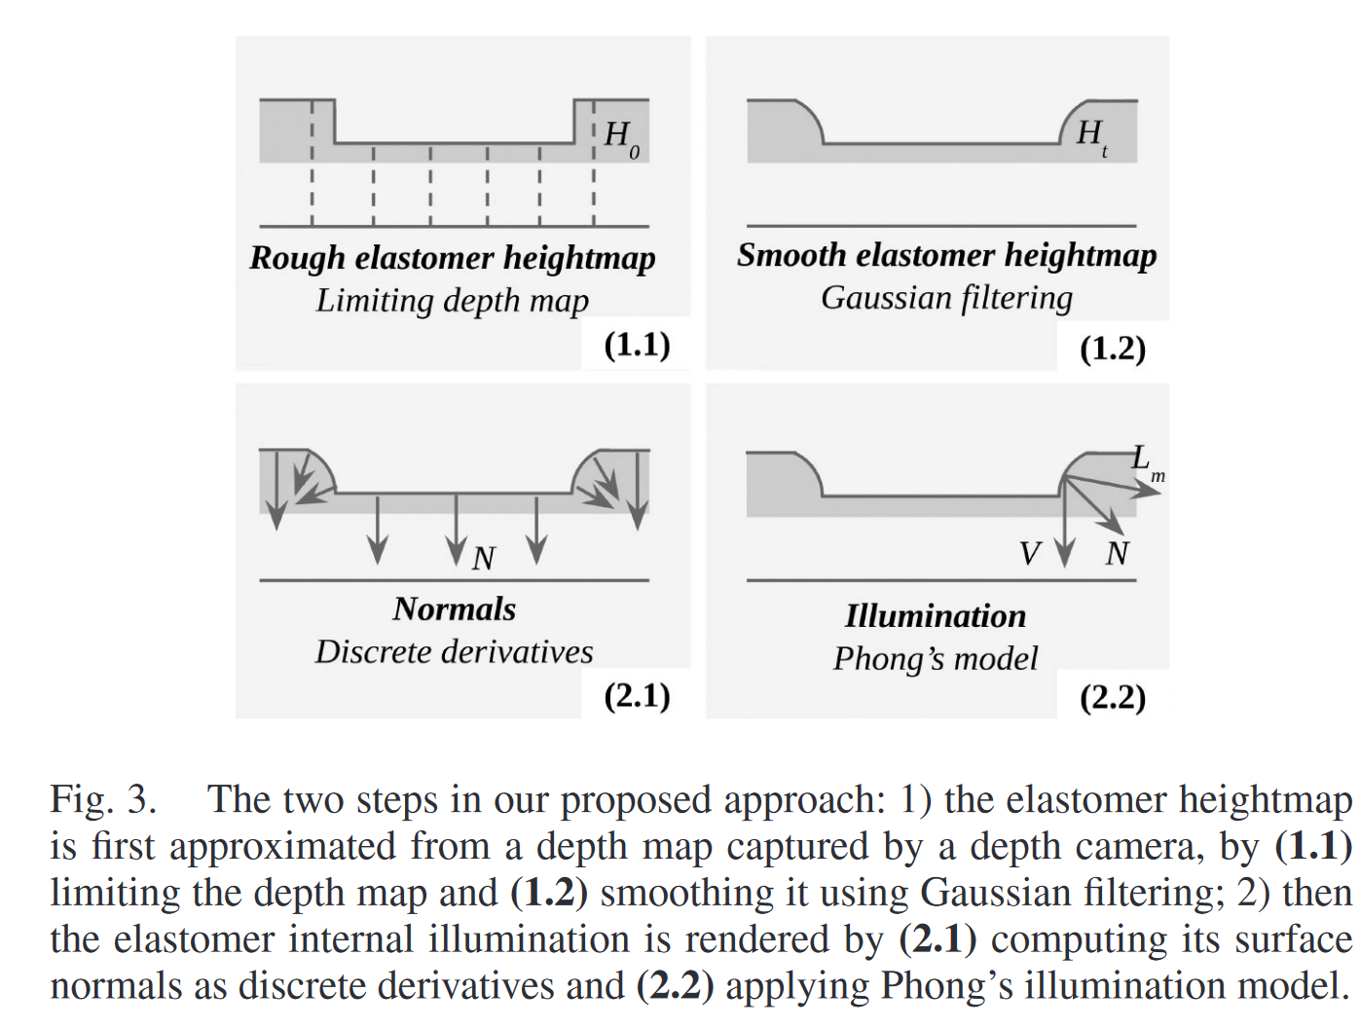
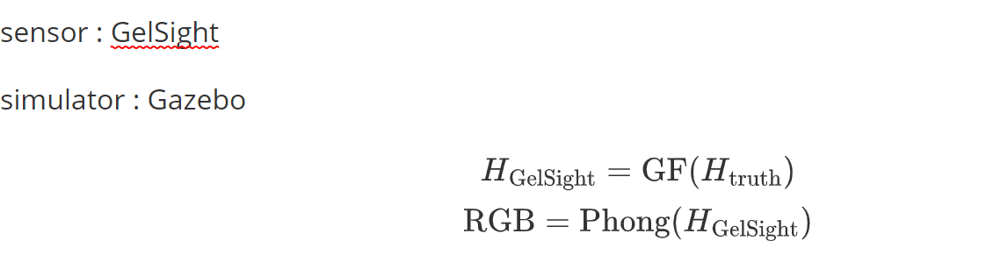
Force Sensor
Simulation Enhancement
Generation of GelSight Tactile Images for Sim2Real Learning
Advantage :
- high resolution
- easy to implement, fast
Limitation :
- Based on the modeling accuracy

Slide 24
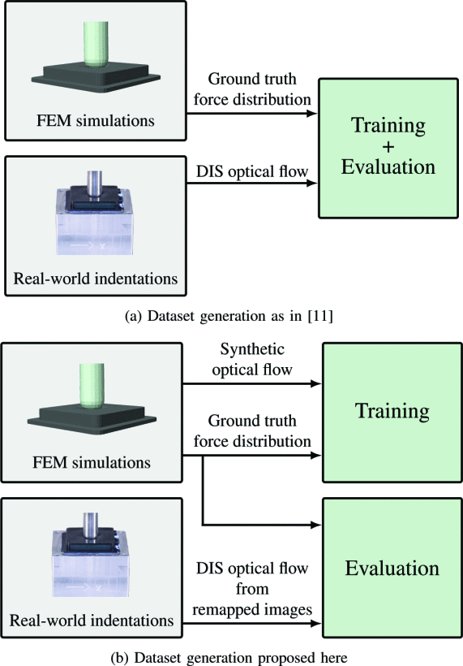
Force Sensor
FEM Simulation
Learning the sense of touch in simulation: a sim-to-real strategy for visionbased tactile sensing
figure a is corresponding to paper "Ground Truth Force Distribution for Learning-Based Tactile Sensing: A Finite Element Approach”
DIS: Dense Inverse Search (Fast Optical Flow using Dense Inverse Search)
Advantage :
- FEM simulation is more precise
Limitation :
- the training result is related to the FEM accuracy

Slide 25
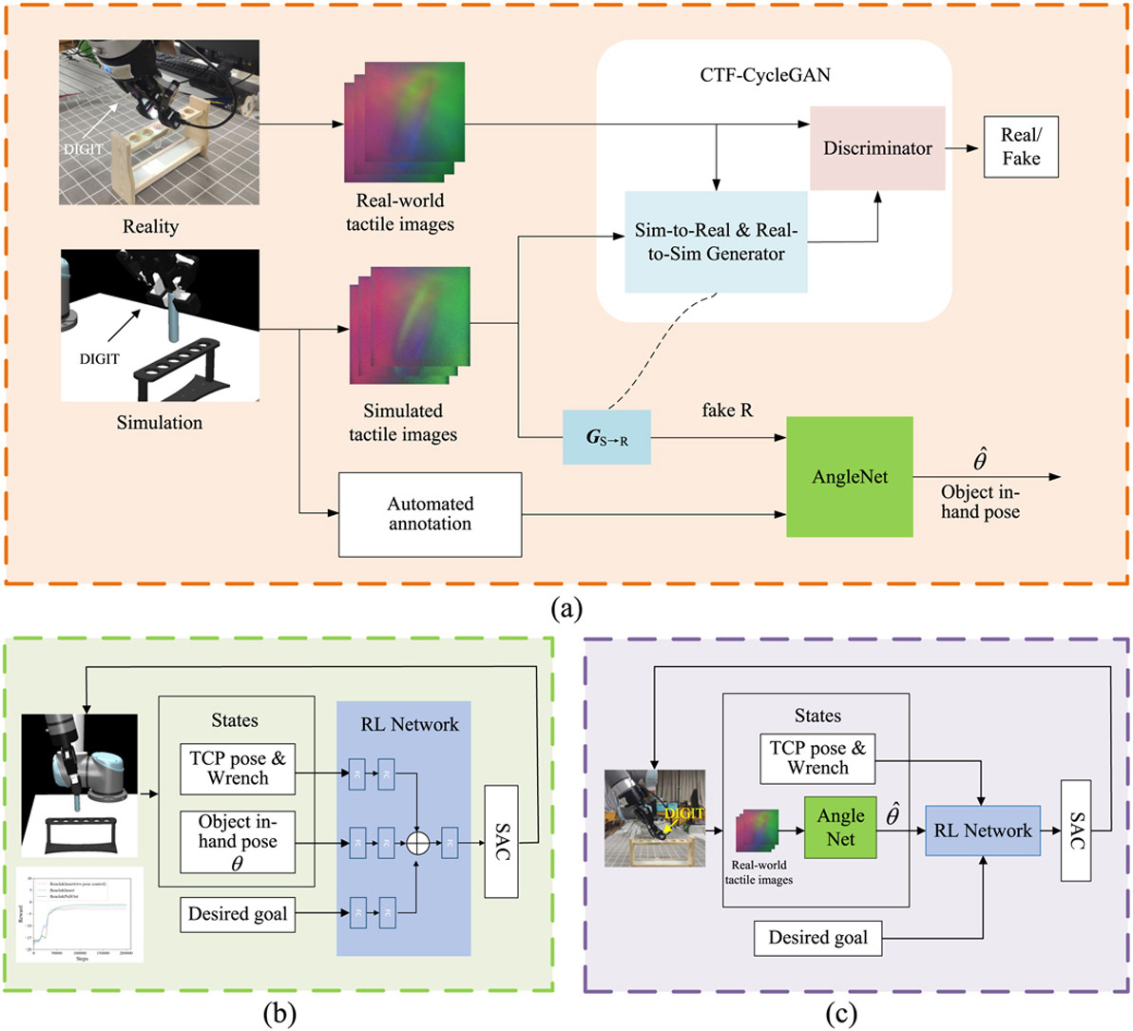
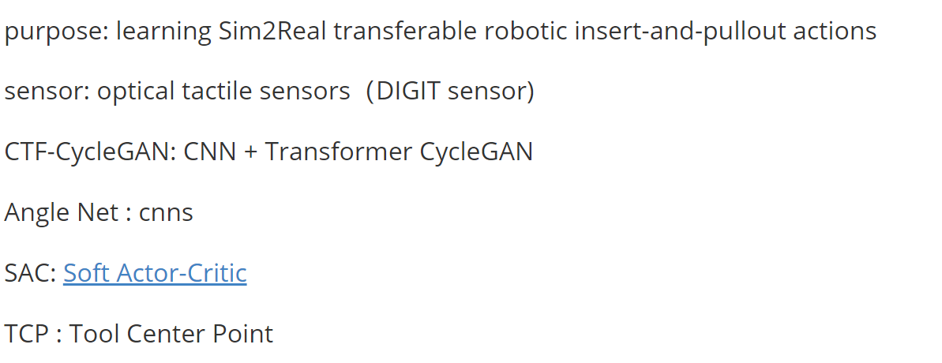
Force Sensor
Simulation Enhancement
Skill generalization of tubular object manipulation with tactile sensing and Sim2Real learning
Advantage :
- use a anglenet to extract angle information from tactile information
Limitation :
- the modeling of DIGIT is fully depend on Gazebo

Slide 26
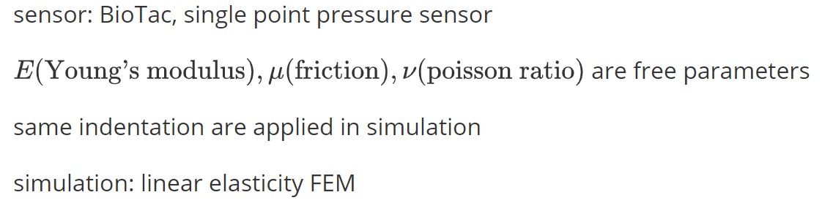
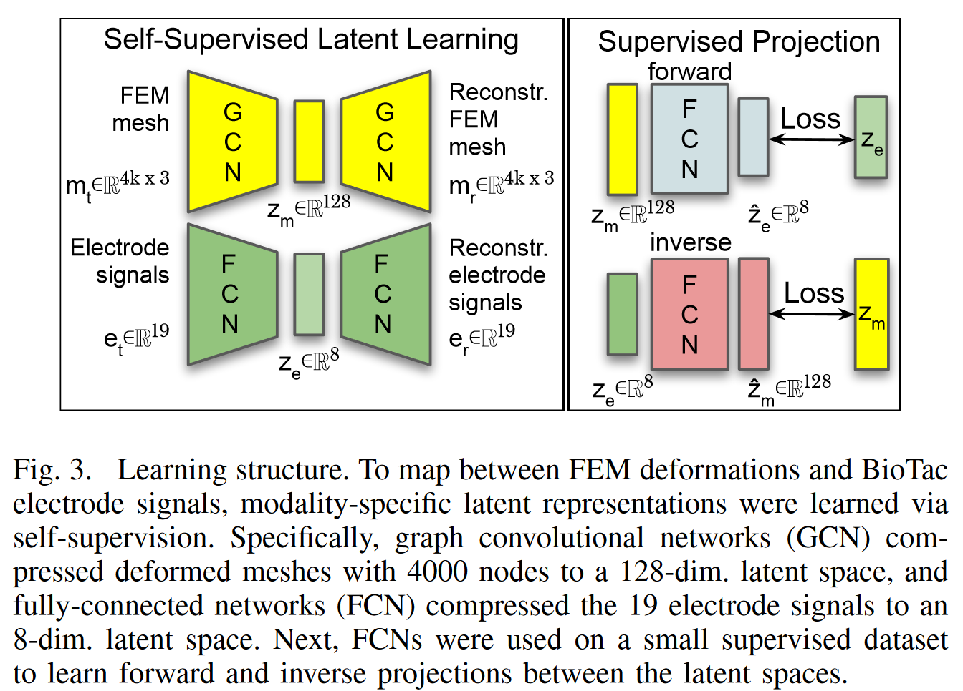
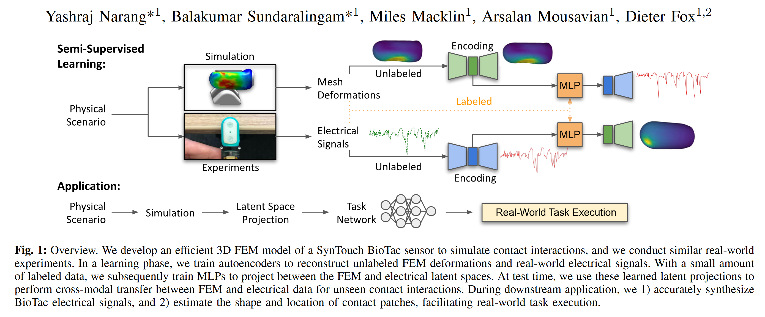
Force Sensor
Advantage :
- 75 faster than previous model
Limitation :
- linear elasticity is not accurate enough
FEM Simulation
Sim-to-Real for Robotic Tactile Sensing via Physics-Based Simulation and Learned Latent Projections

Slide 27
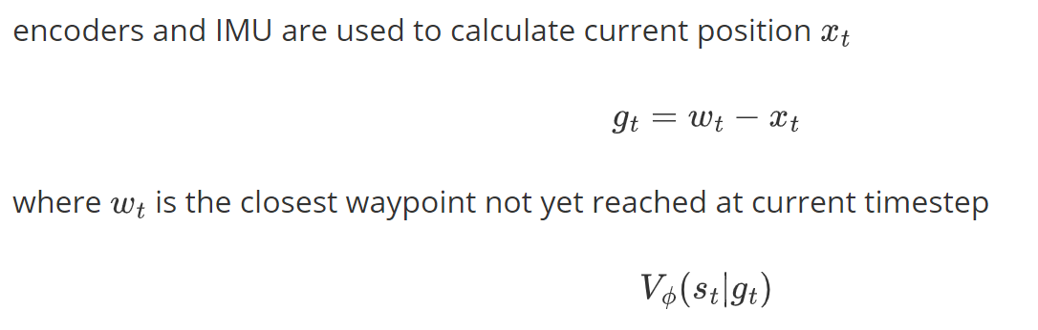
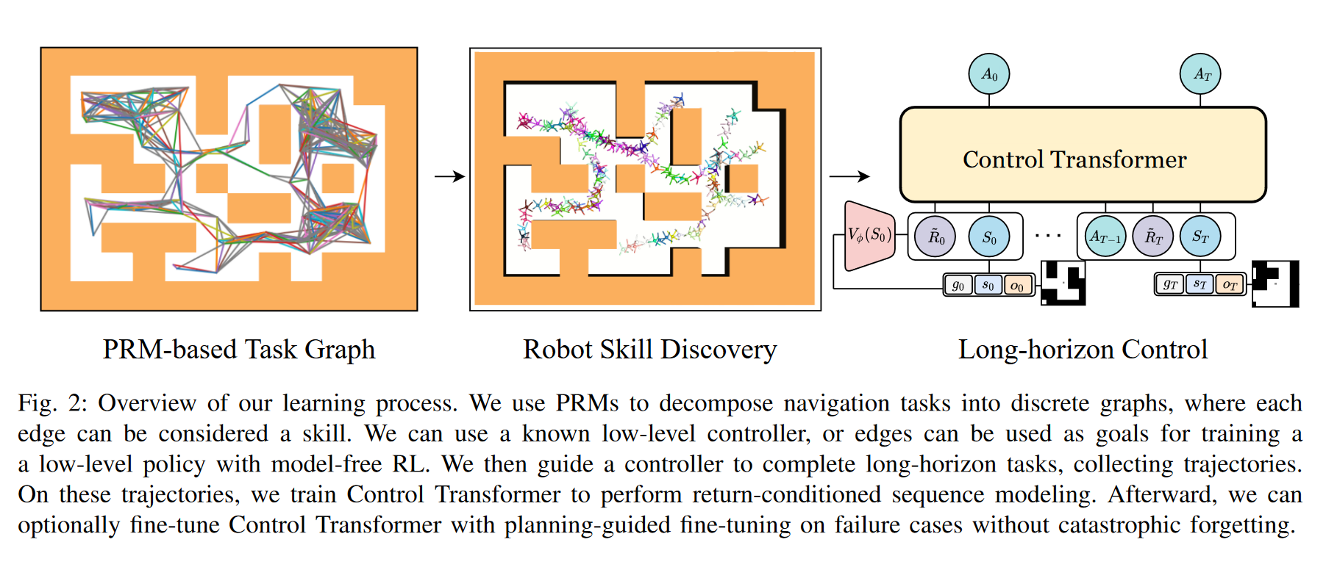
Encoders
Position Esitmation
Control Transformer: Robot Navigation in Unknown Environmentsthrough PRM-Guided Return-Conditioned Sequence Modeling
Advantage :
- effect in complex environment (for policy)
Limitation :
- assume encoders are correct, and use that to compute the error

Slide 28
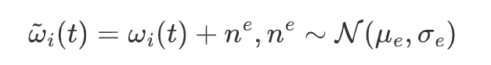
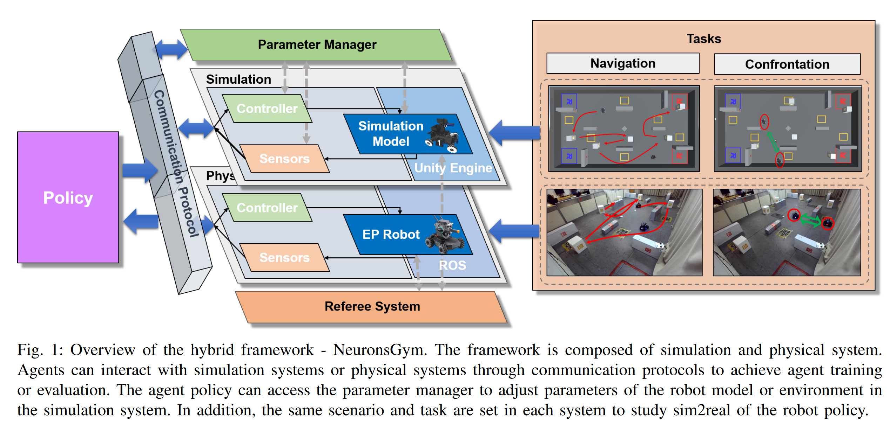
Encoders
Uncertainty Estimation
NeuronsGym: A Hybrid Framework and Benchmark for Robot Tasks with Sim2Real Policy Learning
A simulator framework

Slide 29
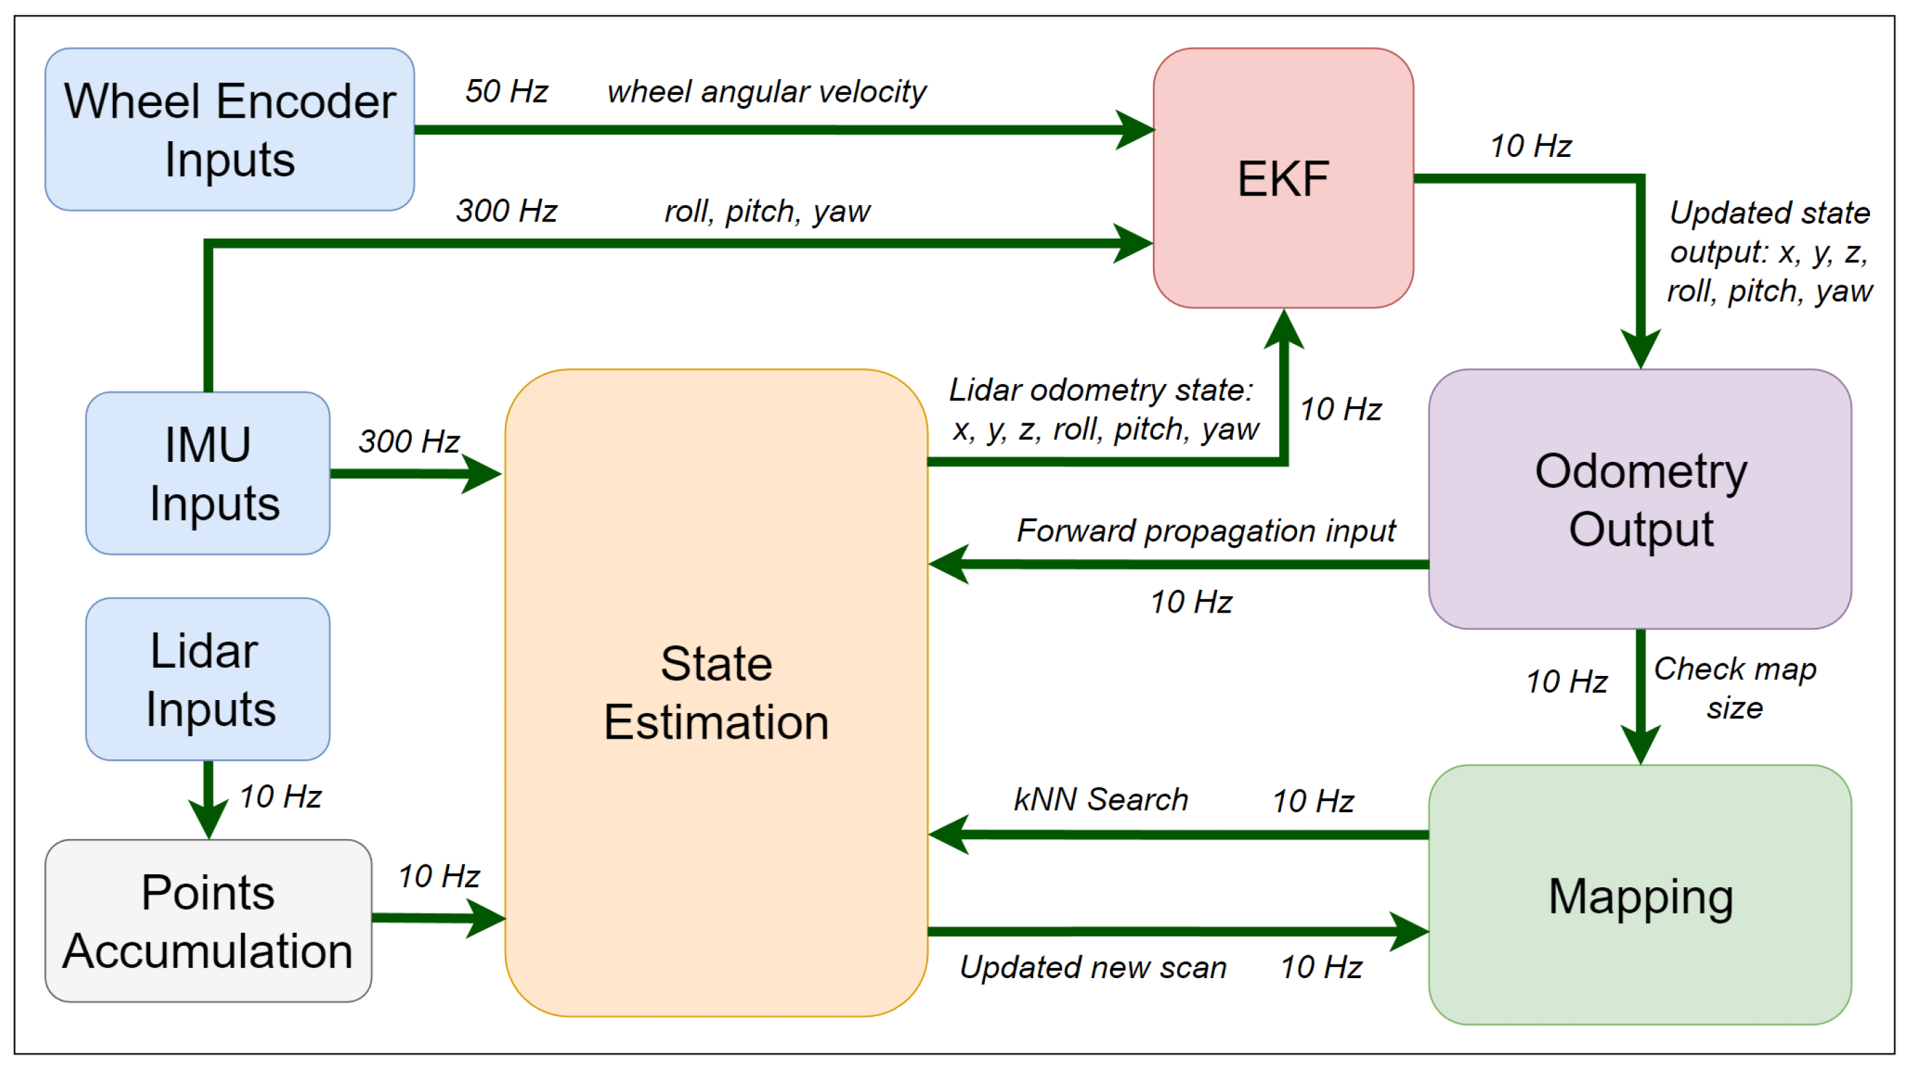
Encoders
Sensor Fusion
LiDAR SLAM with a Wheel Encoder in a Featureless Tunnel Environment
use wheel encoder to correct the LiDAR data, but not related to simulation
Advantage :
- combine IMU, Encoders, LiDAR using extended Kalman Filter
Limitation :
- the algorithm is only validated in flat and inclined terrian

Slide 30
Next Week
Add papers/ delete articles according to today’s assesments
Write report draft and send it by email by the end of 5th Dec

